Slide 1
Location for opening a Restaurant in Mumbai
Tanmay Sharma
17th Oct, 2019

Slide 2
Introduction
Mumbai is the central capital of India.
Food is a must try for each individual visiting India.
What are the important traits to be considered while opening a restaurant in Mumbai
What is the best location for opening a restaurant in Mumbai

Slide 3
Data Acquisition and Cleaning
Data is taken as an excel file from the following link:
https://www.kaggle.com/srivpuneet16/zomato-mumbai-restaurant-analysis
All the restaurants with duplicate names were dropped
Analysis found that Lower Parel had the best restaurants.
Bandra Kurla Complex had most number of restaurants

Slide 4
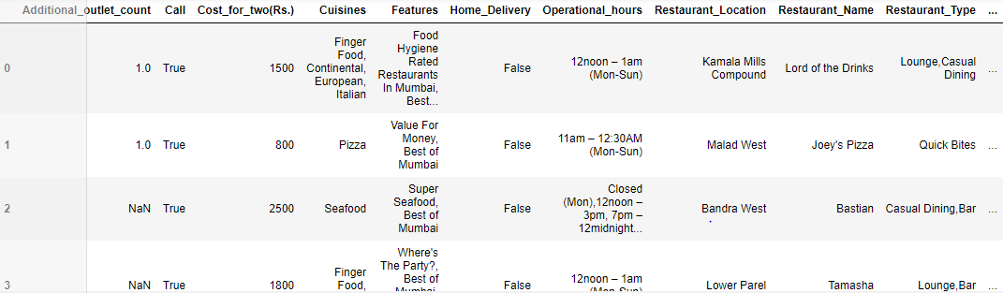
Data

Slide 5
Feature Selection
Latitudes and Longitudes for each restaurant location were determined
Latitude and longitude for Mumbai was determined
All the locations were plotted onto the map
Folium was used.

Slide 6
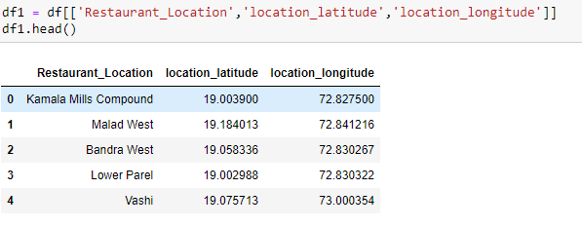
Features

Slide 7
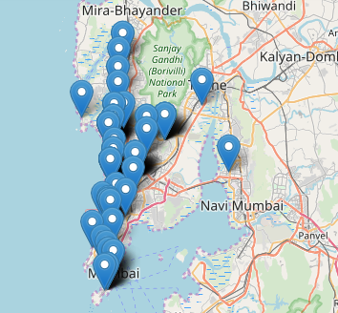

Slide 8
Foursquare API
Provide the Client ID, Client Secret, and Version of Foursquare API
We determine the top 100 venues in a 2000 meters radius.
Venue Category is the main emphasis of our project
All different types of restaurants are taken into consideration.

Slide 9
Clustering
We perform K means clustering of data.
3 clusters are used for clustering.

Slide 10
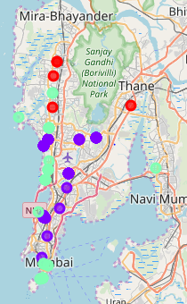

Slide 11
Observation
Cluster 0 has the least number of restaurants.
Restaurant must be opened in either Borivali West, Kandivali West, Goregaon West, or Mahakali.
Prime locations like Kamala Mills Compound, Powai, Juhu, etc must be avoided.
American or Japanese restaurant is a better bet than Café or Indian restaurant as competition is more in the latter.

Slide 12
Future Scope
Data can be evaluated on a larger level.
More Machine Learning algorithms can be incorporated.
More parameters can be considered for evaluation of the entire area.

